Slide 1



Code Style with C#
Presentation

Slide 2
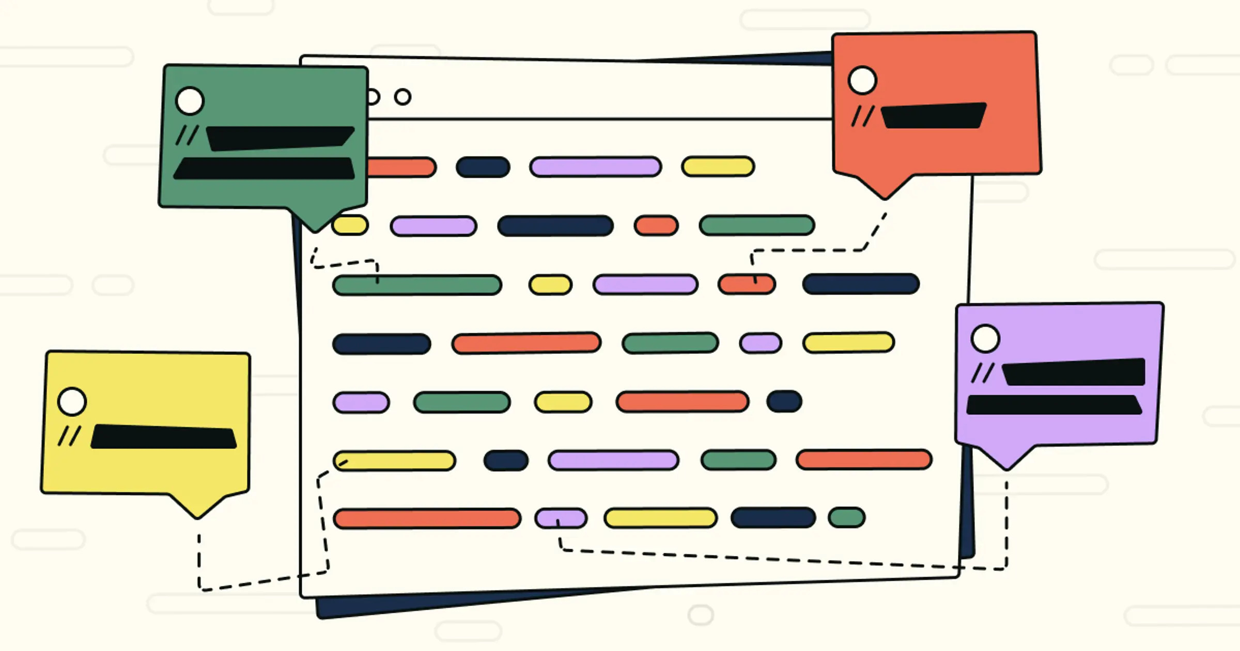
1
How, when to use comments

Slide 3
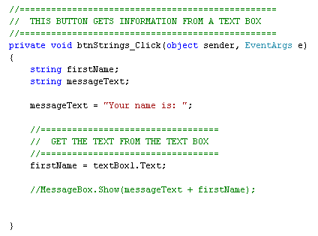
Comments will be used to guide code readers on the functionality of a block of codes, or a function.
A guideline consists of the use of a part will be provided above the designated part.

Slide 4
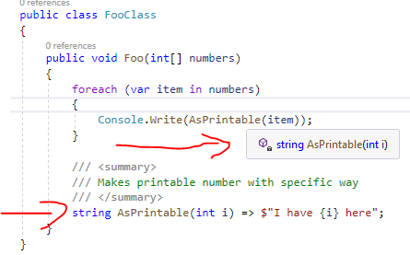
Comments will specify how a variable contributes to the code.
A comment line consists of the use of a variable will be provided above the designated variable.

Slide 5
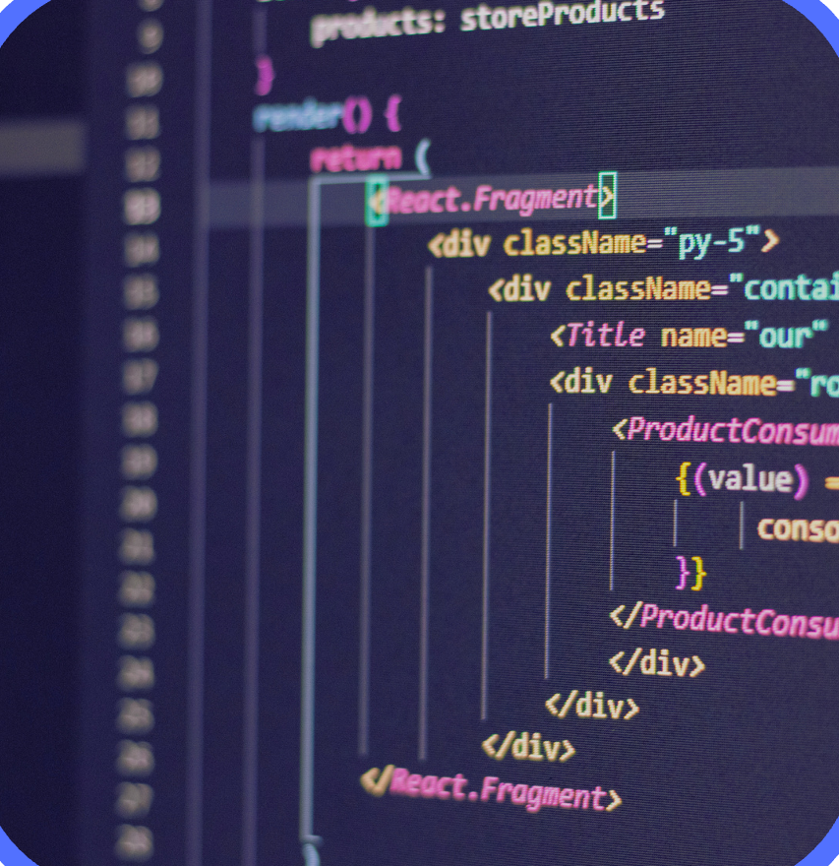
Indentation:
Tab and Spaces
2

Slide 6

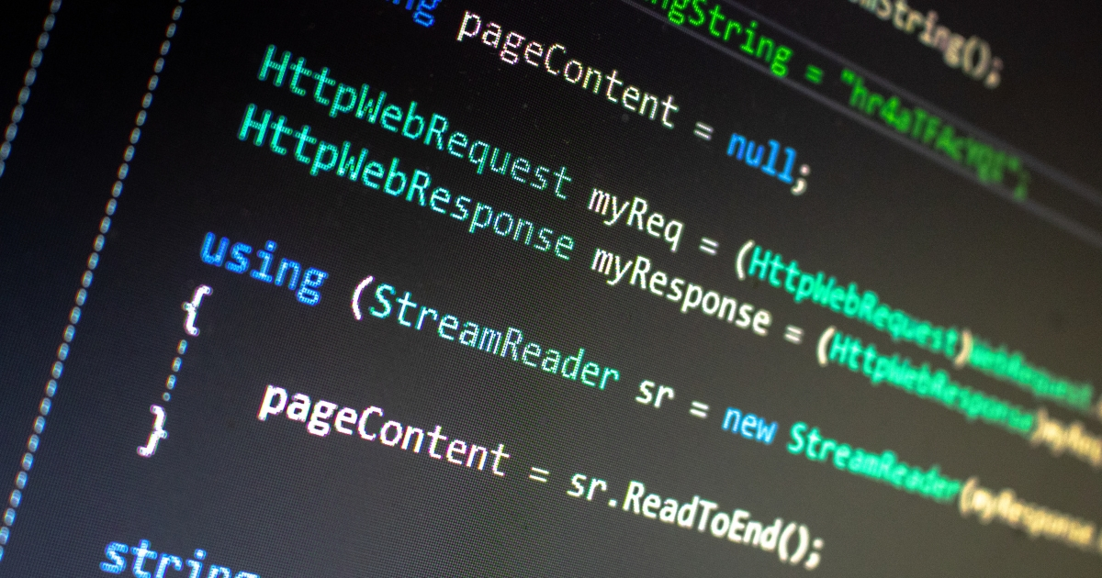
Using Tab when…
Using Space when…
- Writing a new line of code that is “inside” a code block, usually indenting 1 Tab after the {}.
- Spacing between variables that are declared on the same line, or between parameters in a method.
Line spacing when…
- Writing a new part that has a different functionality compared to the previous part.

Slide 7

3
Naming rules

Slide 8

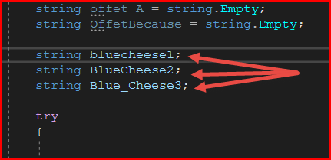
Variables
Prefer readability
Variables
In classes
Short words, capitalize the starting letter of each word, or spacing with “_”.
Insert “_” at the start of its name. Do not capitalize the following letter. (e.g. _userName)
For Boolean variables
Prototype
Add the word “is” before it. (e.g. isVerified)
The same with the corresponding variable in the class, but with the first letter capitalized, and no underline.
(e.g. UserName)

Slide 9
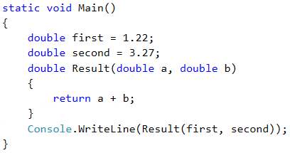
Functions: Prefer usage description
A function name should describe its general functionality in its name.
Example: Add(int a, int b)

Slide 10


Thank you!

